Slide 1
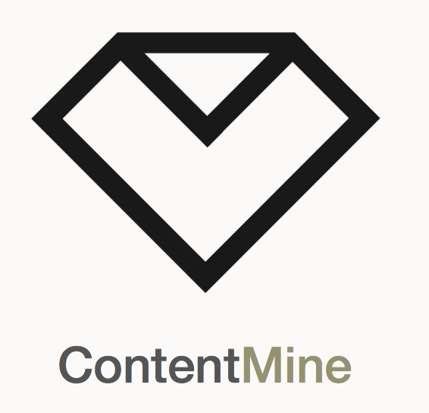




Disrupting the Publisher Academic Complex
Peter Murray-Rust^{1,2}
[1]University of Cambridge
[2]TheContentMine
pm286 AT cam DOT ac DOT uk
Protocol Labs, BL, UK, 2018-04-21
Let’s build a modern Open knowledgebase
which we, not megacorporations, control

Slide 2
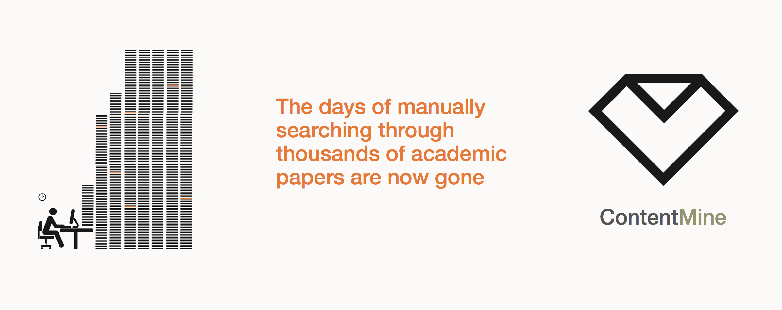
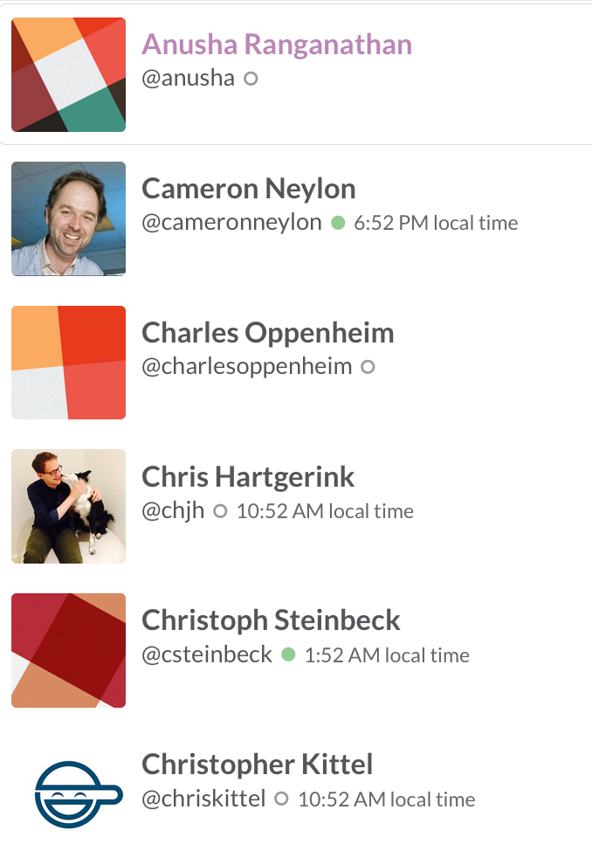
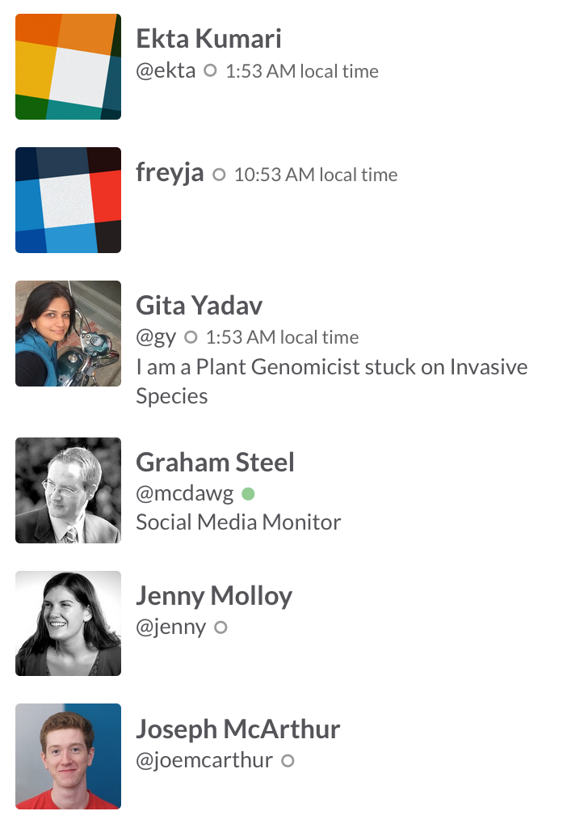
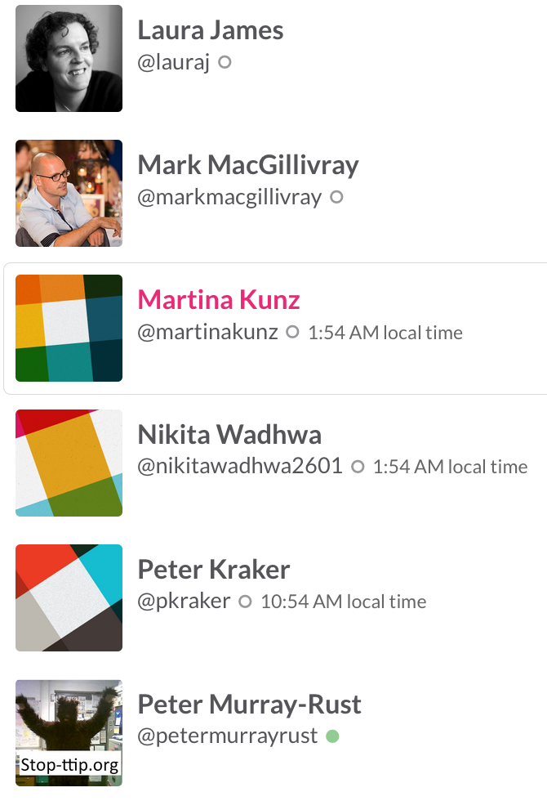
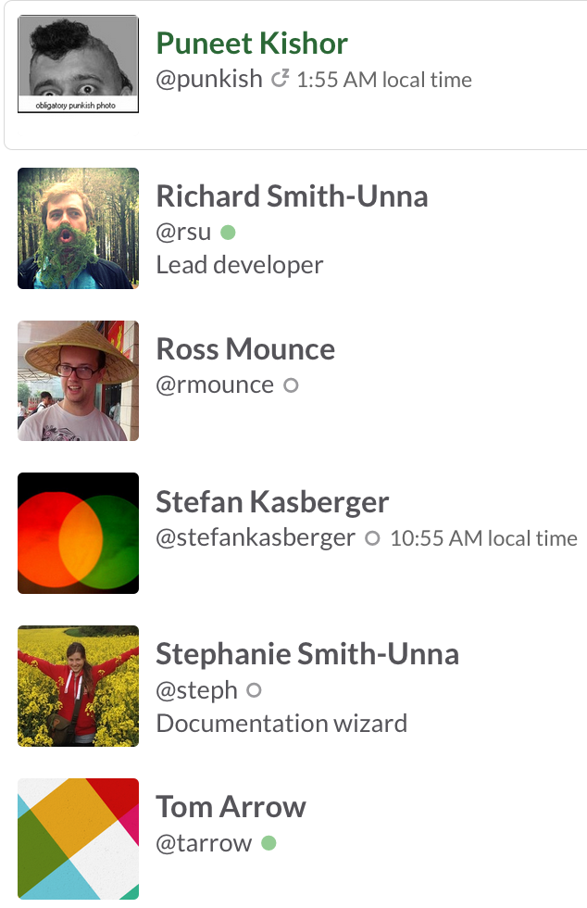
The Right to Read is the Right to Mine
Mining millions of Open facts every week
(2x digital music industry!)
ContentMine is an OpenLocked Non-Profit company

Slide 3
Example of ContentMining
We could mine all chemistry every day …
http://chemicaltagger.ch.cam.ac.uk
… but

Slide 4
#megapub451 [1]
Universal controlled scholarly infrastructure
Surveillance culture
Friendly faces [2], ruthless interior, smart
Amoral
Political
Rich; Inelastic vanity market
Bigger than recording industry
NO GOVERNANCE
[1] cf Fahrenheit451 (Ray Bradbury). Firemen burn books; megapub encloses knowledge
[2] discourse: “help” , “collaborate”, “partner”
Compare: Monsanto, Volkswagen, TimeWarner, Facebook, Royal Bank Scotland, Exxon, Pfizer, Telcos, Transport, etc.

Slide 5
Opening Knowledge overcomes injustice
Open comes from the heart.
Closed Access Means People Die.
Megacorporations are pwning the knowledge infrastructure/
The Right to Read is the Right to Mine
Young people change the world. Give them the chance.
ACT: Advocacy , Community, Tools

Slide 6
Problem
Advocacy/Activism
Community
Tools

Slide 7
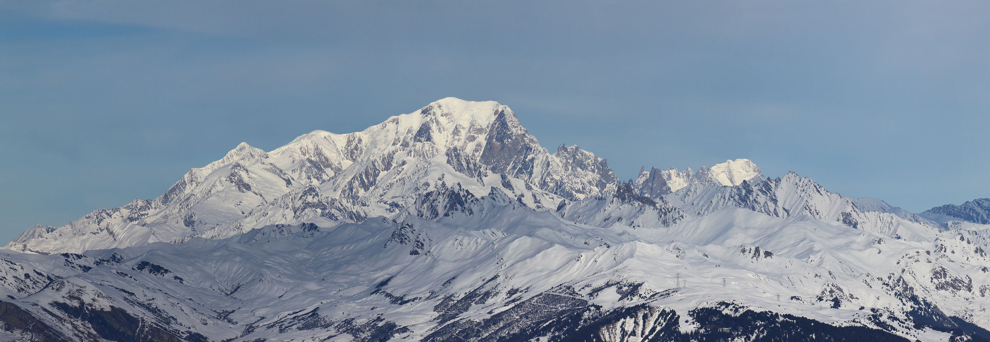
Scholarly publishing is “Big Data”
1 year’s scholarly output!
$20 Billion market
$500 Billion public research => 2.5 million articles /year , 7000 /day
Most is not Publicly readable and much is unused
ContentMining (TDM) can liberate knowledge
Many mega-publishers fight ContentMining
[1] http://www.crossref.org/01company/crossref_indicators.html
[2] https://en.wikipedia.org/wiki/Mont_Blanc#/media/File:Mont_Blanc_depuis_Valmorel.jpg

Slide 8
BENEFITS OF CONTENT MINING
Hague Declaration 2015
Addressing grand challenges such as climate change and global epidemics
Improving population health, wealth and development
Creating new jobs and employment
Exponentially increasing the speed and progress of science through new insights and greater efficiency of research
Increasing transparency of governments and their actions
Fostering innovation and collaboration and boosting the impact of open science
Creating tools for education and research
Providing new and richer cultural insights
Speeding economic and social development in all parts of the globe

Slide 9
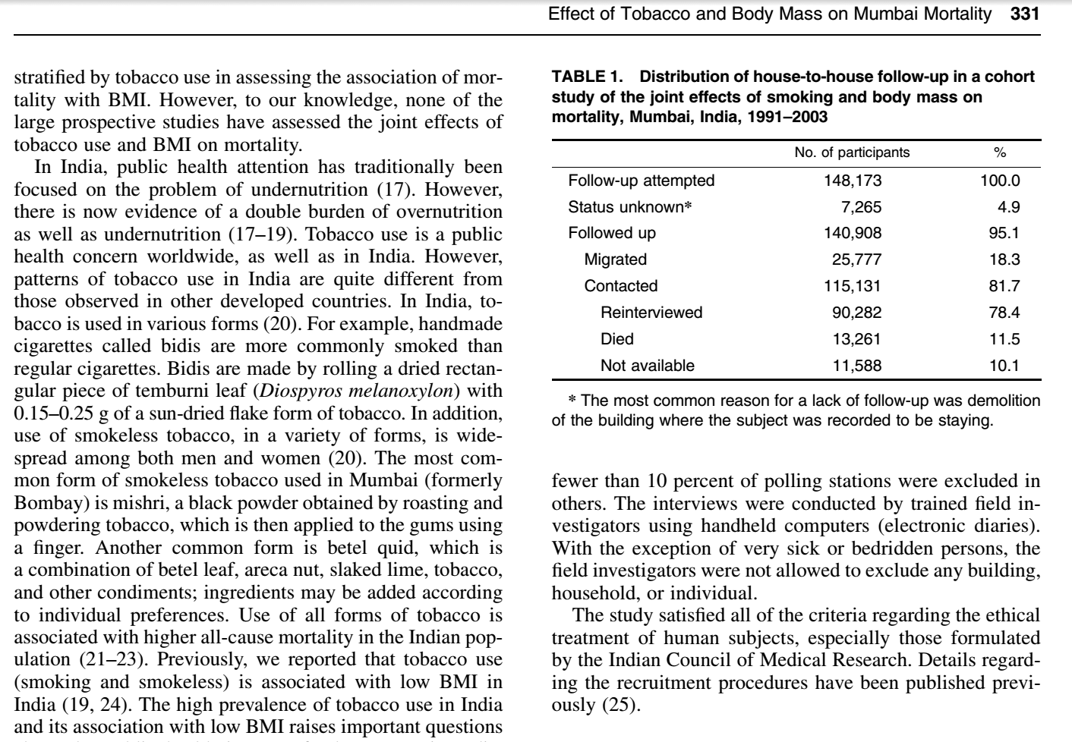
Polly: “there were 10,000 abstracts and due
to time pressures, we split this between 6 researchers. It took about 2-3 days of work (working only on this) to get through
~1,600 papers each. So, at a minimum this
equates to 12 days of full-time work (and would normally be done over several weeks under normal time pressures).”
ContentMine software can do this in a few minutes

Slide 10
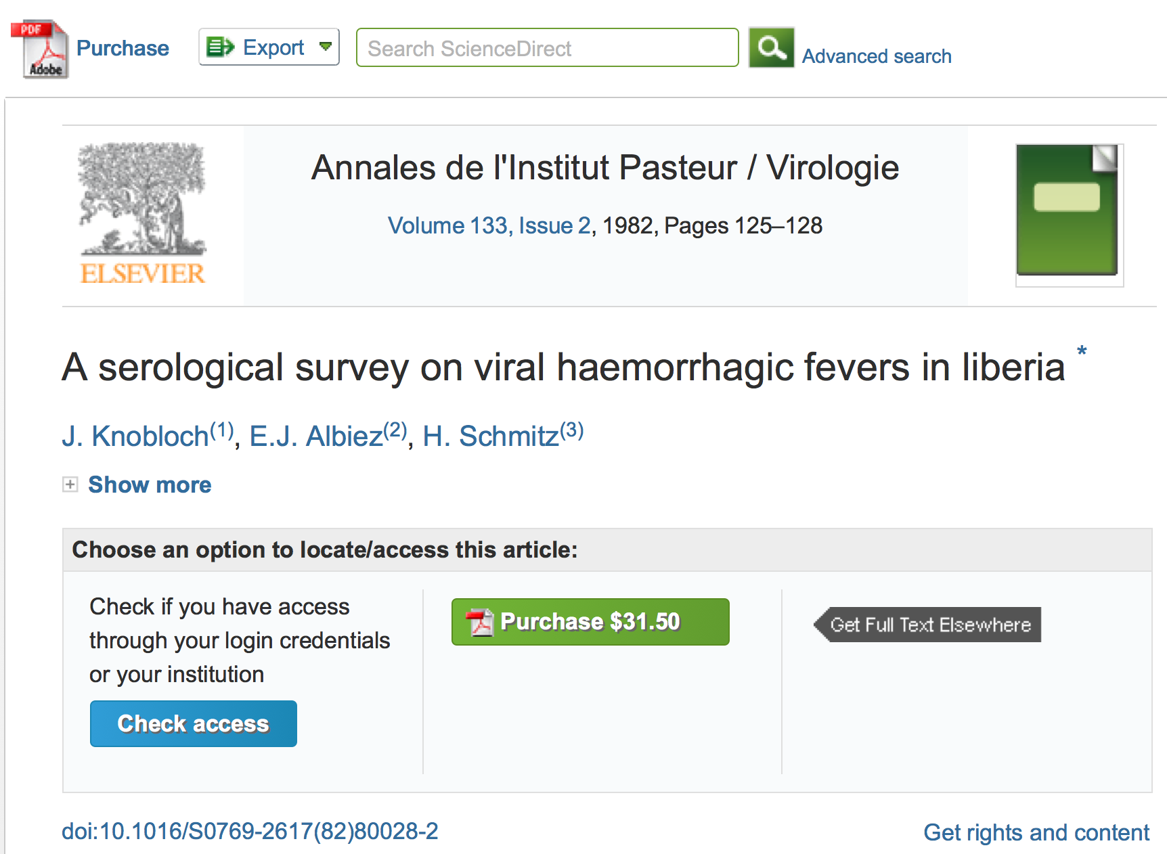
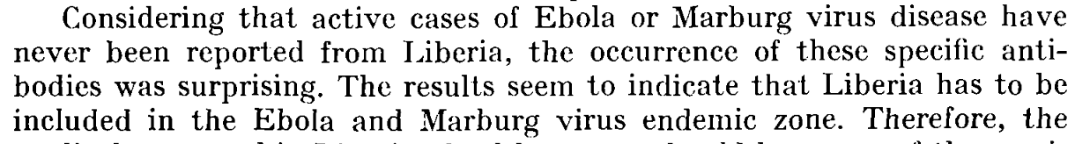

Slide 11
A System Failure of Scholarly Publishing
http://www.nytimes.com/2015/04/08/opinion/yes-we-were-warned-about-ebola.html
We were stunned recently when we stumbled across an article by European researchers in Annals of Virology [1982]: “The results seem to indicate that Liberia has to be included in the Ebola virus endemic zone.” In the future, the authors asserted, “medical personnel in Liberian health centers should be aware of the possibility that they may come across active cases and thus be prepared to avoid nosocomial epidemics,” referring to hospital-acquired infection.
Adage in public health: “The road to inaction is paved with research papers.”
Bernice Dahn (chief medical officer of Liberia’s Ministry of Health)
Vera Mussah (director of county health services)
Cameron Nutt (Ebola response adviser to Partners in Health)

Slide 12
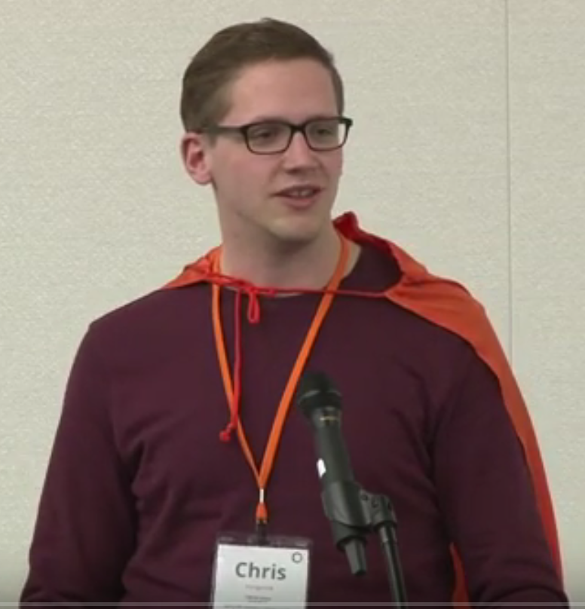
Chris Hartgerink
Tilburg University (NL)
Reproducible Science
Extracting statistical information
Helping authors check
reported results
Detecting problematic study
results (e.g., clinical trials)

Slide 13
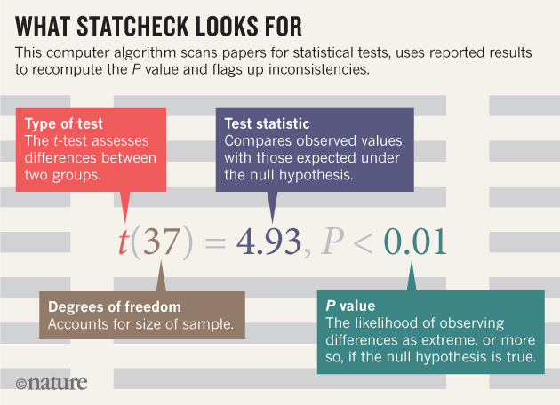
[1]
[1] STATCHECK from Chris Hartgerink

Slide 14
And now the main problem…

Slide 15
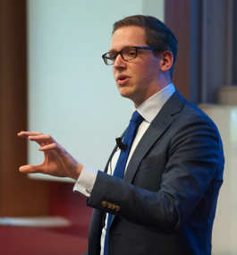
Elsevier stopped me doing my research
Chris Hartgerink
@Senficon (Julia Reda) :Text & Data mining in times of #copyright maximalism:
"Elsevier stopped me doing my research" http://onsnetwork.org/chartgerink/2015/11/16/elsevier-stopped-me-doing-my-research/ … #opencon #TDM

Slide 16
Chris Hartgerink’s blog post
I am a statistician interested in detecting potentially problematic research such as data fabrication, which results in unreliable findings and can harm policy-making, confound funding decisions, and hampers research progress.
To this end, I am content mining results reported in the psychology literature. Content mining the literature is a valuable avenue of investigating research questions with innovative methods. For example, our research group has written an automated program to mine research papers for errors in the reported results and found that 1/8 papers (of 30,000) contains at least one result that could directly influence the substantive conclusion [1].
In new research, I am trying to extract test results, figures, tables, and other information reported in papers throughout the majority of the psychology literature. As such, I need the research papers published in psychology that I can mine for these data. To this end, I started ‘bulk’ downloading research papers from, for instance, Sciencedirect. I was doing this for scholarly purposes and took into account potential server load by limiting the amount of papers I downloaded per minute to 9. I had no intention to redistribute the downloaded materials, had legal access to them because my university pays a subscription, and I only wanted to extract facts from these papers.
Full disclosure, I downloaded approximately 30GB of data from Sciencedirect in approximately 10 days. This boils down to a server load of 0.0021GB/[min], 0.125GB/h, 3GB/day.
Approximately two weeks after I started downloading psychology research papers, Elsevier notified my university that this was a violation of the access contract, that this could be considered stealing of content, and that they wanted it to stop. My librarian explicitly instructed me to stop downloading (which I did immediately), otherwise Elsevier would cut all access to Sciencedirect for my university.
I am now not able to mine a substantial part of the literature, and because of this Elsevier is directly hampering me in my research.
[1] Nuijten, M. B., Hartgerink, C. H. J., van Assen, M. A. L. M., Epskamp, S., & Wicherts, J. M. (2015). The prevalence of statistical reporting errors in psychology (1985–2013). Behavior Research Methods, 1–22. doi: 10.3758/s13428-015-0664-2

Slide 17
Wiley also stopped me (Chris Hartgerink) doing my research
In November, I wrote about how Elsevier wanted me to stop downloading scientific articles for my research. Today, Wiley also ordered me to stop downloading.
As a quick recapitulation: I am a statistician doing research into detecting potentially problematic research such as data fabrication and estimating how often it occurs. For this, I need to download many scientific articles, because my research applies content mining methods that extract facts from them (e.g., test statistics). These facts serve as my data to answer my research questions. If I cannot download these research articles, I cannot collect the data I need to do my research.
I was downloading psychology research articles from the Wiley library, with a maximum of 5 per minute. I did this using the tool quickscrape, developed by the ContentMine organization. With this, I have downloaded approximately 18,680 research articles from the Wiley library, which I was downloading solely for research purposes.
Wiley noticed my downloading and notified my university library that they detected a compromised proxy, which they had immediately restricted. They called it “illegally downloading copyrighted content licensed by your institution”. However, at no point was there any investigation into whether my user credentials were actually compromised (they were not). Whether I had legitimate reasons to download these articles was never discussed. The original email from Wiley is available here.
As a result of Wiley denying me to download these research articles, I cannot collect data from another one of the big publishers, alongside Elsevier. Wiley is more strict than Elsevier by immediately condemning the downloading as illegal, whereas Elsevier offers an (inadequate) API with additional terms of use (while legitimate access has already been obtained). I am really confused about what the publisher’s stance on content mining is, because Sage and Springer seemingly allow it; I have downloaded 150,210 research articles from Springer and 12,971 from Sage and they never complained about it.
http://onsnetwork.org/chartgerink/2016/02/23/wiley-also-stopped-my-doing-my-research/

Slide 18
STM Publishers prevent Mining
FUD & disinformation about legality (Elsevier)
Monopolies on infrastructure (“API”s, CCC Rightfind)
Technical obstruction (Wiley Captcha, Macmillan Readcube)
Restrictive contracts with libraries (ALL) [1]
Wasting my/our time (ALL)
[1] [You may not] utilize the TDM Output to enhance … subject repositories in a way that would [… ] have the potential to substitute and/or replicate any other existing Elsevier products, services and/or solutions.

Slide 19
Copyright Problems
By default Copyright forbids everything until proved otherwise.
Clear answers are often only available when you defend yourself in court
Language is not precise.
“non-commercial”
“fair redistribution”
“public interest research organization”
Scientific Researchers using mining live in a constant state of Fear-Uncertainty-Doubt.
Legal reform is a necessary but not sufficient solution.

Slide 20
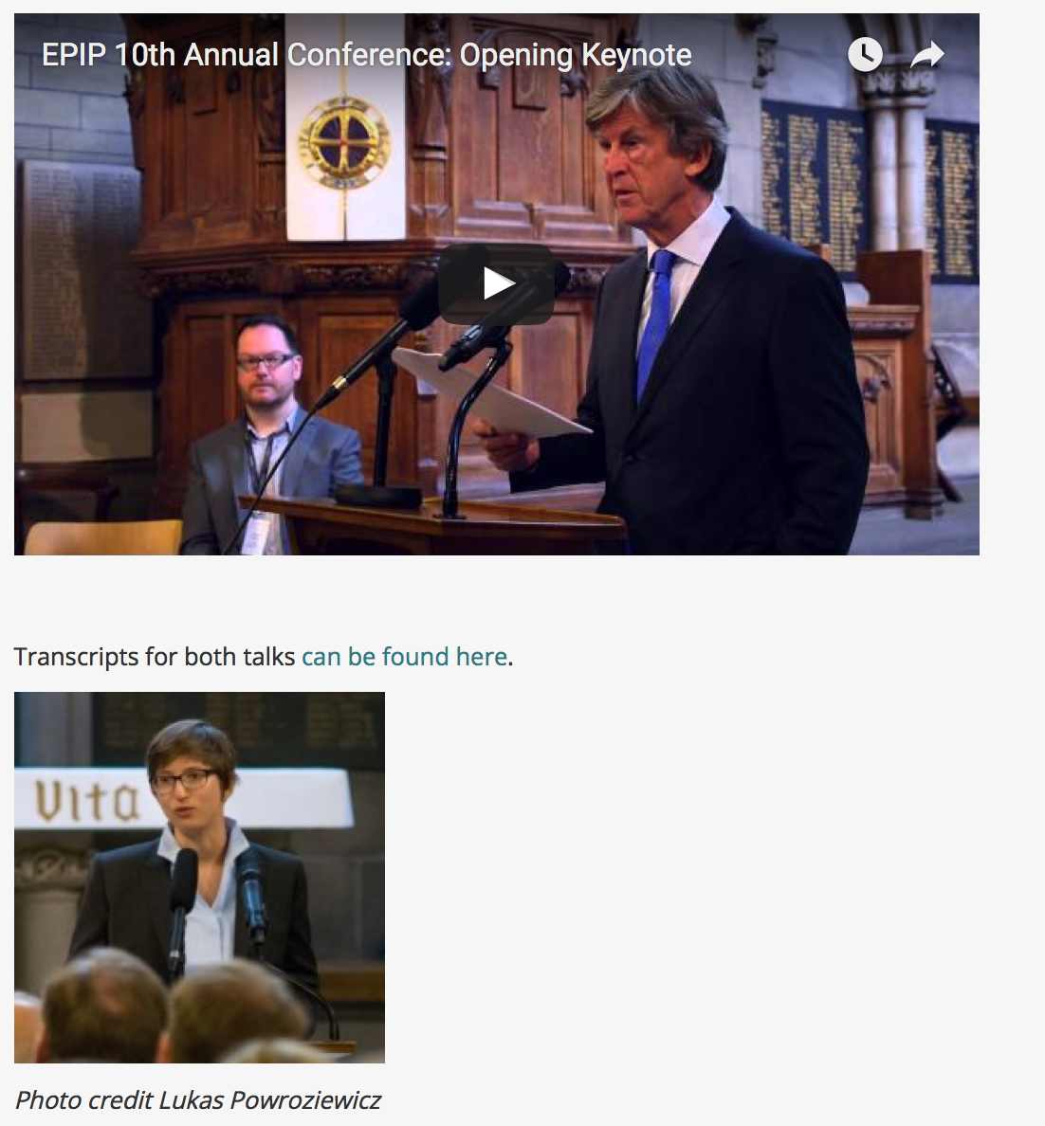
Julia Reda MEP
there’s a serious risk of Europe digging itself deeper into a digital black hole on copyright,
Prof Ian Hargreaves:
…make sure that the voices of the digital many are not drowned out in policy discussions by the digitally self-interested few.
Julia Reda MEP
The current copyright regime is undermining our ability to produce evidence. It is time that academics in large numbers … speak up about this issue. Decreasing the very substantial burdens and transaction costs for research and education is one of the declared goals of the Commission’s copyright reform proposal, and the European Parliament has echoed that sentiment in my report.
http://www.create.ac.uk/blog/2015/09/16/epip2015-opening-keynote-response-transcript/

Slide 21
The Publisher-Academic complex[1]
$$,
MS
review
Taxpayer
Library
$$
Publishers
$$
Academia
Student
Glory+?
in-kind
Researcher
[1] The Military-Industrial-Academic complex (1961)
(Dwight D Eisenhower, US President)

Slide 22
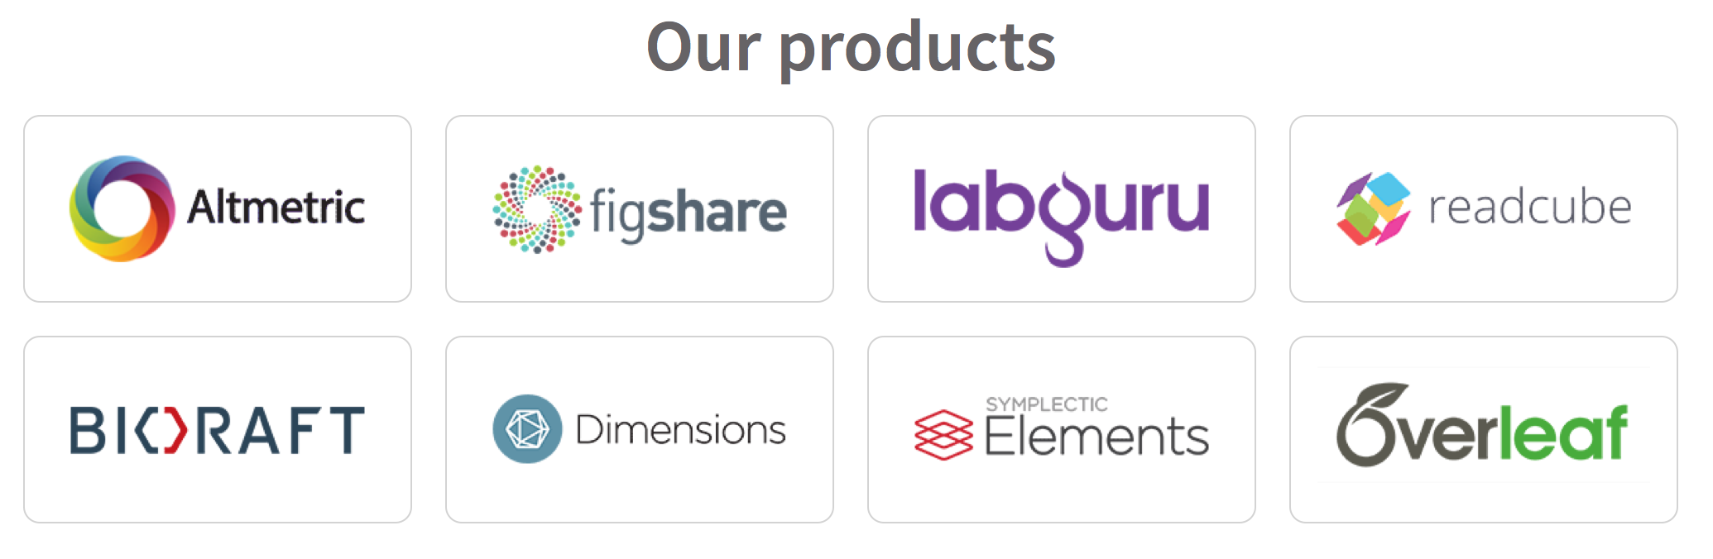
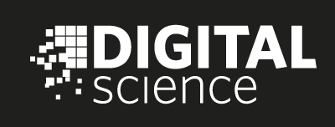









Scholarly infrastructure becomes closed
No accountability for monitoring and control

Slide 23
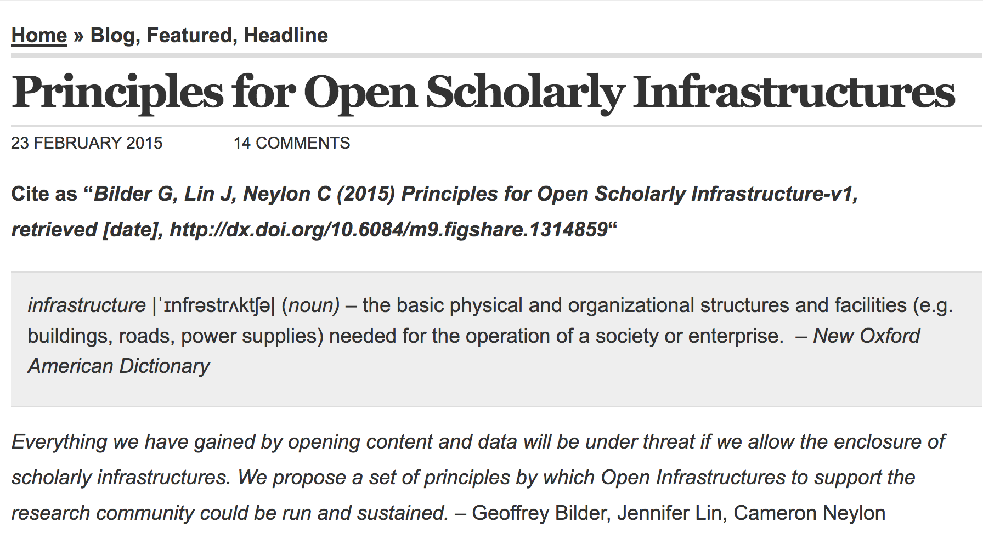

Slide 24
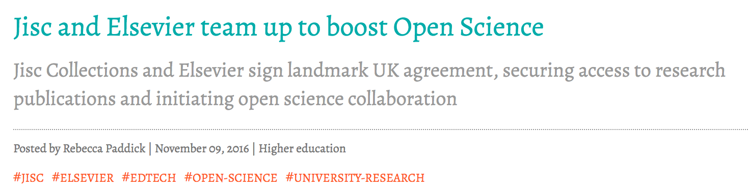

Slide 25
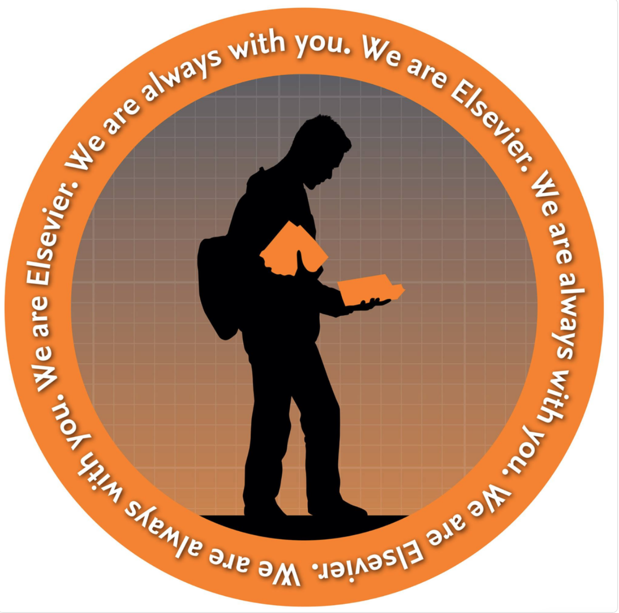
Elsevier Marketing to Medical Students 2017

Slide 26
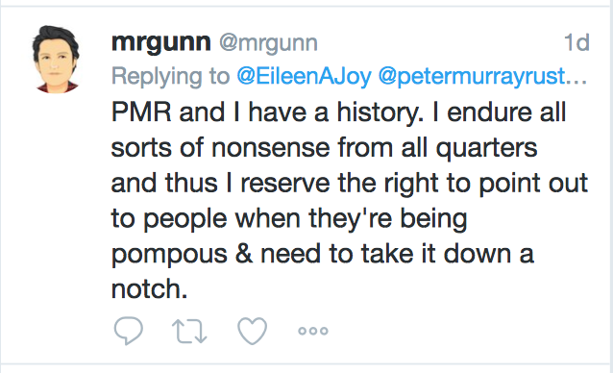
Elsevier’s Director of Scholarly Communication

Slide 27
Problem
Advocacy/Activism
Community
Tools

Slide 28
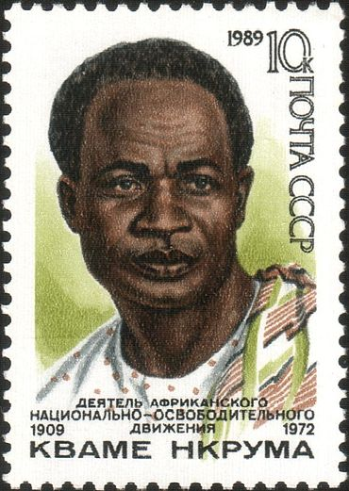
Neocolonialism
In place of colonialism, as the main instrument of imperialism, we have today neo-colonialism . . . [which] like colonialism, is an attempt to export the social conflicts of the capitalist countries. . . .
The result of neo-colonialism is that foreign capital is used for the exploitation rather than for the development of the less developed parts of the world. Investment, under neo-colonialism, increases, rather than decreases, the gap between the rich and the poor countries of the world. The struggle against neo-colonialism is not aimed at excluding the capital of the developed world from operating in less developed countries. It is aimed at preventing the financial power of the developed countries being used in such a way as to impoverish the less developed.[5]
Kwame Nkrumah 1965 Neo-Colonialism, The Last Stage of Imperialism.
Text and Image: Wikimedia Commons

Slide 29
Knowledge Neocolonialism/Capitalism
The result of [knowledge colonialism] is that [corporate] capital is used for the exploitation rather than for the development of the less developed parts of the [knowledge] world.
Investment, under [knowledge imperialism], increases, rather than decreases, the gap between the rich and the poor [scholars] of the world. The struggle against [knowledge neocolonialism] […] is aimed at preventing the financial power of the [megacorporations] being used in such a way as to impoverish the [scholarly poor]less developed.[5]
(adapted by PMR from Kwame Nkrumah) s/country/scholar/, s/colonial power/megacorporation/

Slide 30
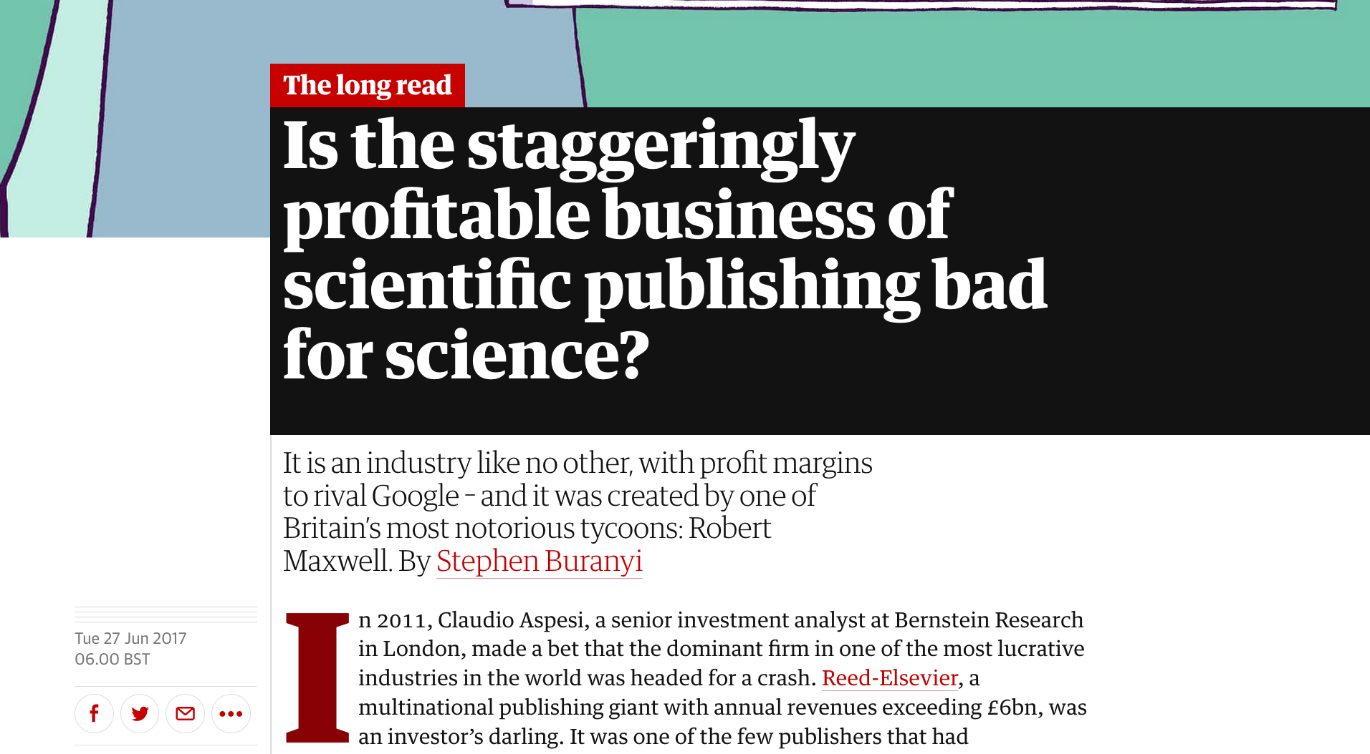

Slide 31
The publishing business is “perverse and needless”, the Berkeley biologist Michael Eisen wrote in a 2003 article for the Guardian, declaring that it “should be a public scandal”.

Slide 32
With total global revenues of more than £19bn, it weighs in somewhere between the recording and the film industries in size, but it is far more profitable. In 2010, Elsevier’s scientific publishing arm reported profits of £724m on just over £2bn in revenue. It was a 36% margin – higher than Apple, Google, or Amazon posted that year.

Slide 33
Improbable as it might sound, few people in the last century have done more to shape the way science is conducted today than Maxwell.
He always said we don’t compete on sales, we compete on authors,” Albert Henderson, a former deputy director at Pergamon, told me. “We would attend conferences specifically looking to recruit editors for new journals.”

Slide 34
A good idea, a conversation or correspondence, even from the most brilliant person in the world … doesn’t count for anything unless you have it published,” says Neal Young of the NIH. If you control access to the scientific literature, it is, to all intents and purposes, like controlling science.

Slide 35
“Lewin was clever. He realised scientists are very vain, and wanted to be part of this selective members club; Cell was ‘it’, and you had to get your paper in there,” Schekman said.

Slide 36
If I don’t publish in CNS [Cell/Nature/Science], I won’t get a job,” says Schekman. He compared the pursuit of high-impact publications to an incentive system as rotten as banking bonuses.

Slide 37
but it was university librarians who first realised the trap in the market Maxwell had created. The librarians used university funds to buy journals on behalf of scientists. Maxwell was well aware of this. “Scientists are not as price-conscious as other professionals, mainly because they are not spending their own money,” And since there was no way to swap one journal for another, cheaper one, the result was, Maxwell continued, “a perpetual financing machine”. Librarians were locked into a series of thousands of tiny monopolies.

Slide 38
Sci-Hub – a sort of Napster for science that allows anyone to download scientific papers for free. Its creator, Alexandra Elbakyan, a Kazhakstani, is in hiding, facing charges of hacking and copyright infringement in the US. Elsevier recently obtained a $15m injunction (the maximum allowable amount) against her.
Elbakyan is an unabashed utopian. “Science should belong to scientists and not the publishers,” she told me in an email. In a letter to the court, she cited Article 27 of the UN’s Universal Declaration of Human Rights, asserting the right “to share in scientific advancement and its benefits”.

Slide 39
“Free” and “Open”
"Free software is a matter of liberty, not price. ’free speech', not 'free beer'”. (R M Stallman)
“A piece of data or content is open if anyone is free to use, reuse, and redistribute it” (OKFN)http://opendefinition.org/
“open” (access) has multiple incompatible “definitions”. Major split is “human eyeballs” vs copying and machine “reusability”
“Open” is a marketing term for publishers, who frequently (often deliberately) do not grant full Openness.
“Gratis” vs “Libre”

Slide 40
Critical Historical Open Events
Free Software Foundation (RMS, 1985) and Linux (Torvalds, 1991)
The World Wide Web (TBL, 1991)
The human genome (1990-2001)
The life of Aaron Swartz (1986-2013)

Slide 41
http://www.budapestopenaccessinitiative.org/read
… an unprecedented public good. …
… completely free and unrestricted access to [peer-reviewed literature] by all scientists, scholars, teachers, students, and other curious minds. …
…Removing access barriers to this literature will accelerate research, enrich education, share the learning of the rich with the poor and the poor with the rich, make this literature as useful as it can be, and lay the foundation for uniting humanity in a common intellectual conversation and quest for knowledge.
(Budapest Open Access Initiative, 2003)

Slide 42
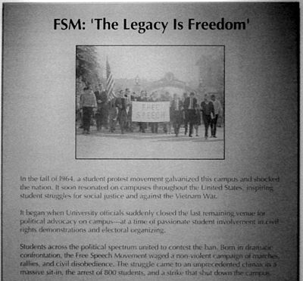
The Free Speech Movement
Univ California,
Berkeley 1964
[Wikipedia:] On the steps of Sproul Hall [Student] Mario Savio gave a famous speech
... But we're a bunch of raw materials that don't mean … to end up being bought by some clients of the University, be they the government, be they industry, be they organized labor, be they anyone! We're human beings! ... There's a time when the operation of the machine becomes so odious — makes you so sick at heart — that you can't take part. You can't even passively take part. And you've got to put your bodies upon the gears and upon the wheels, upon the levers, upon all the apparatus, and you've got to make it stop. And you've got to indicate to the people who run it, to the people who own it, that unless you're free, the machine will be prevented from working at all. ^{[1]}

Slide 43
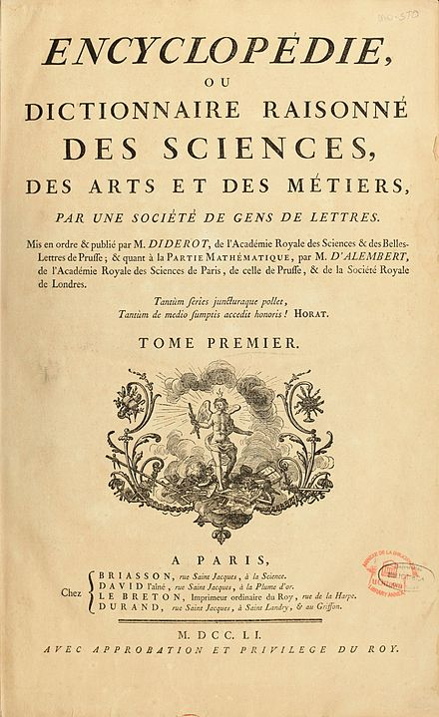

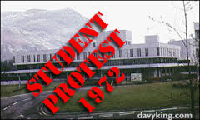
The Digital Enlightenment: some of my icons
Berkeley, US, 1966
Paris, 1968
UK, 1969-73
Diderot, Paris, 1751

Slide 44
We must control our scholarship
Publishers are preventing scholars from using the literature for scientific research.
APIs mean Snoop, Control and Censor.
Snoop: publishers monitor who is using the literature , when and for what
Control: publishers control what you get, when, how much, and in what form
Censor: publishers control what results you publish and how.
The Right to Read is the Right to Mine

Slide 45
Neocolonialism
In place of colonialism, as the main instrument of imperialism, we have today neo-colonialism . . . [which] like colonialism, is an attempt to export the social conflicts of the capitalist countries. . . .
The result of neo-colonialism is that foreign capital is used for the exploitation rather than for the development of the less developed parts of the world. Investment, under neo-colonialism, increases, rather than decreases, the gap between the rich and the poor countries of the world. The struggle against neo-colonialism is not aimed at excluding the capital of the developed world from operating in less developed countries. It is aimed at preventing the financial power of the developed countries being used in such a way as to impoverish the less developed.[5]
Kwame Nkrumah 1965 Neo-Colonialism, The Last Stage of Imperialism.
Text and Image: Wikimedia Commons

Slide 46
Knowledge Neocolonialism/Capitalism
The result of [knowledge colonialism] is that [corporate] capital is used for the exploitation rather than for the development of the less developed parts of the [knowledge] world.
Investment, under [knowledge imperialism], increases, rather than decreases, the gap between the rich and the poor [scholars] of the world. The struggle against [knowledge neocolonialism] […] is aimed at preventing the financial power of the [megacorporations] being used in such a way as to impoverish the less developed.[5]
(adapted by PMR from Kwame Nkrumah) s/country/scholar/, s/colonial power/megacorporation/

Slide 47
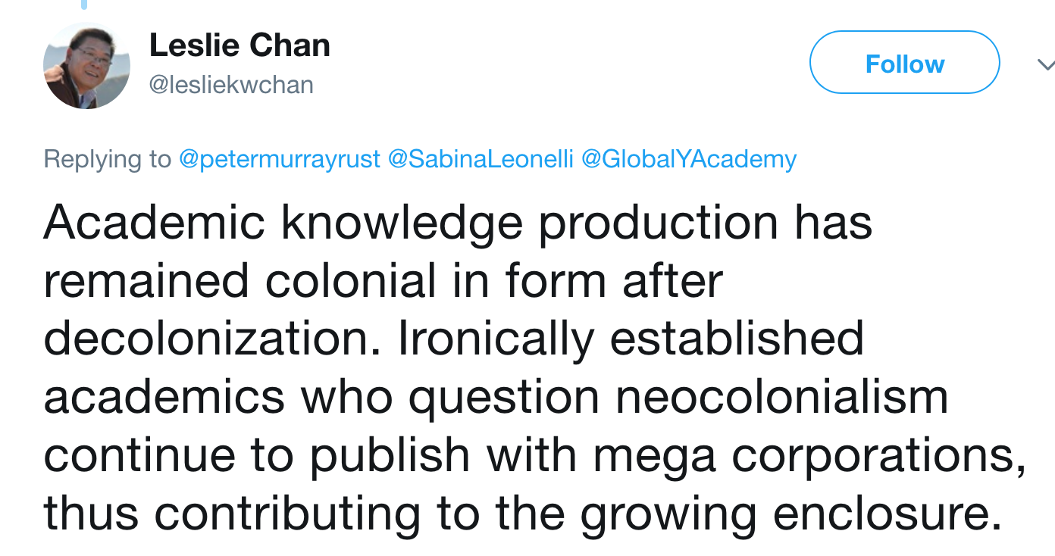
Immediate reply from Leslie Chan

Slide 48
Everything we have gained by opening content and data will be under threat if we allow the enclosure of scholarly infrastructures. We propose a set of principles by which Open Infrastructures to support the research community could be run and sustained. – Geoffrey Bilder, Jennifer Lin, Cameron Neylon. 2015
2017 Jisc and Elsevier develop “Open Science for UK”
2017 Elsevier develops “Open Science for EC”

Slide 49
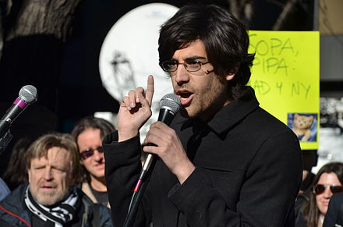
Aaron Swartz
["How We Stopped SOPA”:
This bill ... shut down whole websites. Essentially, it stopped Americans from communicating entirely with certain groups....
I called all my friends, and we stayed up all night setting up a website for this new group, Demand Progress, with an online petition opposing this noxious bill.... We [got] ... 300,000 signers.... We met with the staff of members of Congress and pleaded with them.... And then it passed unanimously....
And then, suddenly, the process stopped. Senator Ron Wyden ... put a hold on the bill.[48][49]
He added, "We won this fight because everyone made themselves the hero of their own story. Everyone took it as their job to save this crucial freedom.”
Robert Swartz: "Aaron was killed by the government, and MIT betrayed all of its basic principles."^{[116]}

Slide 50


Slide 51
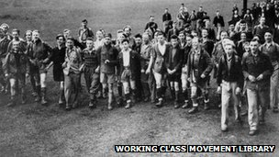
The Right to Read is
The Right to Roam
Kinder Mass Trespass
used without permission but with love and thanks
The Right to Mine

Slide 52
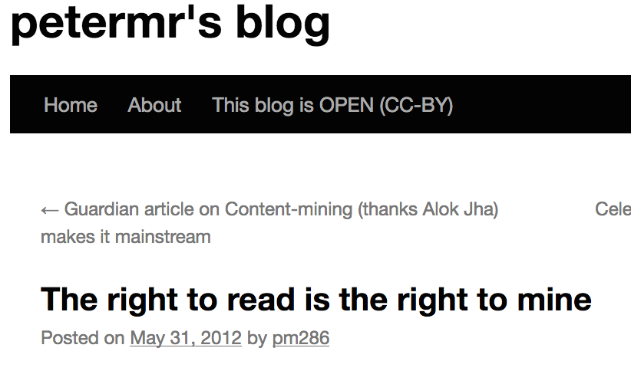
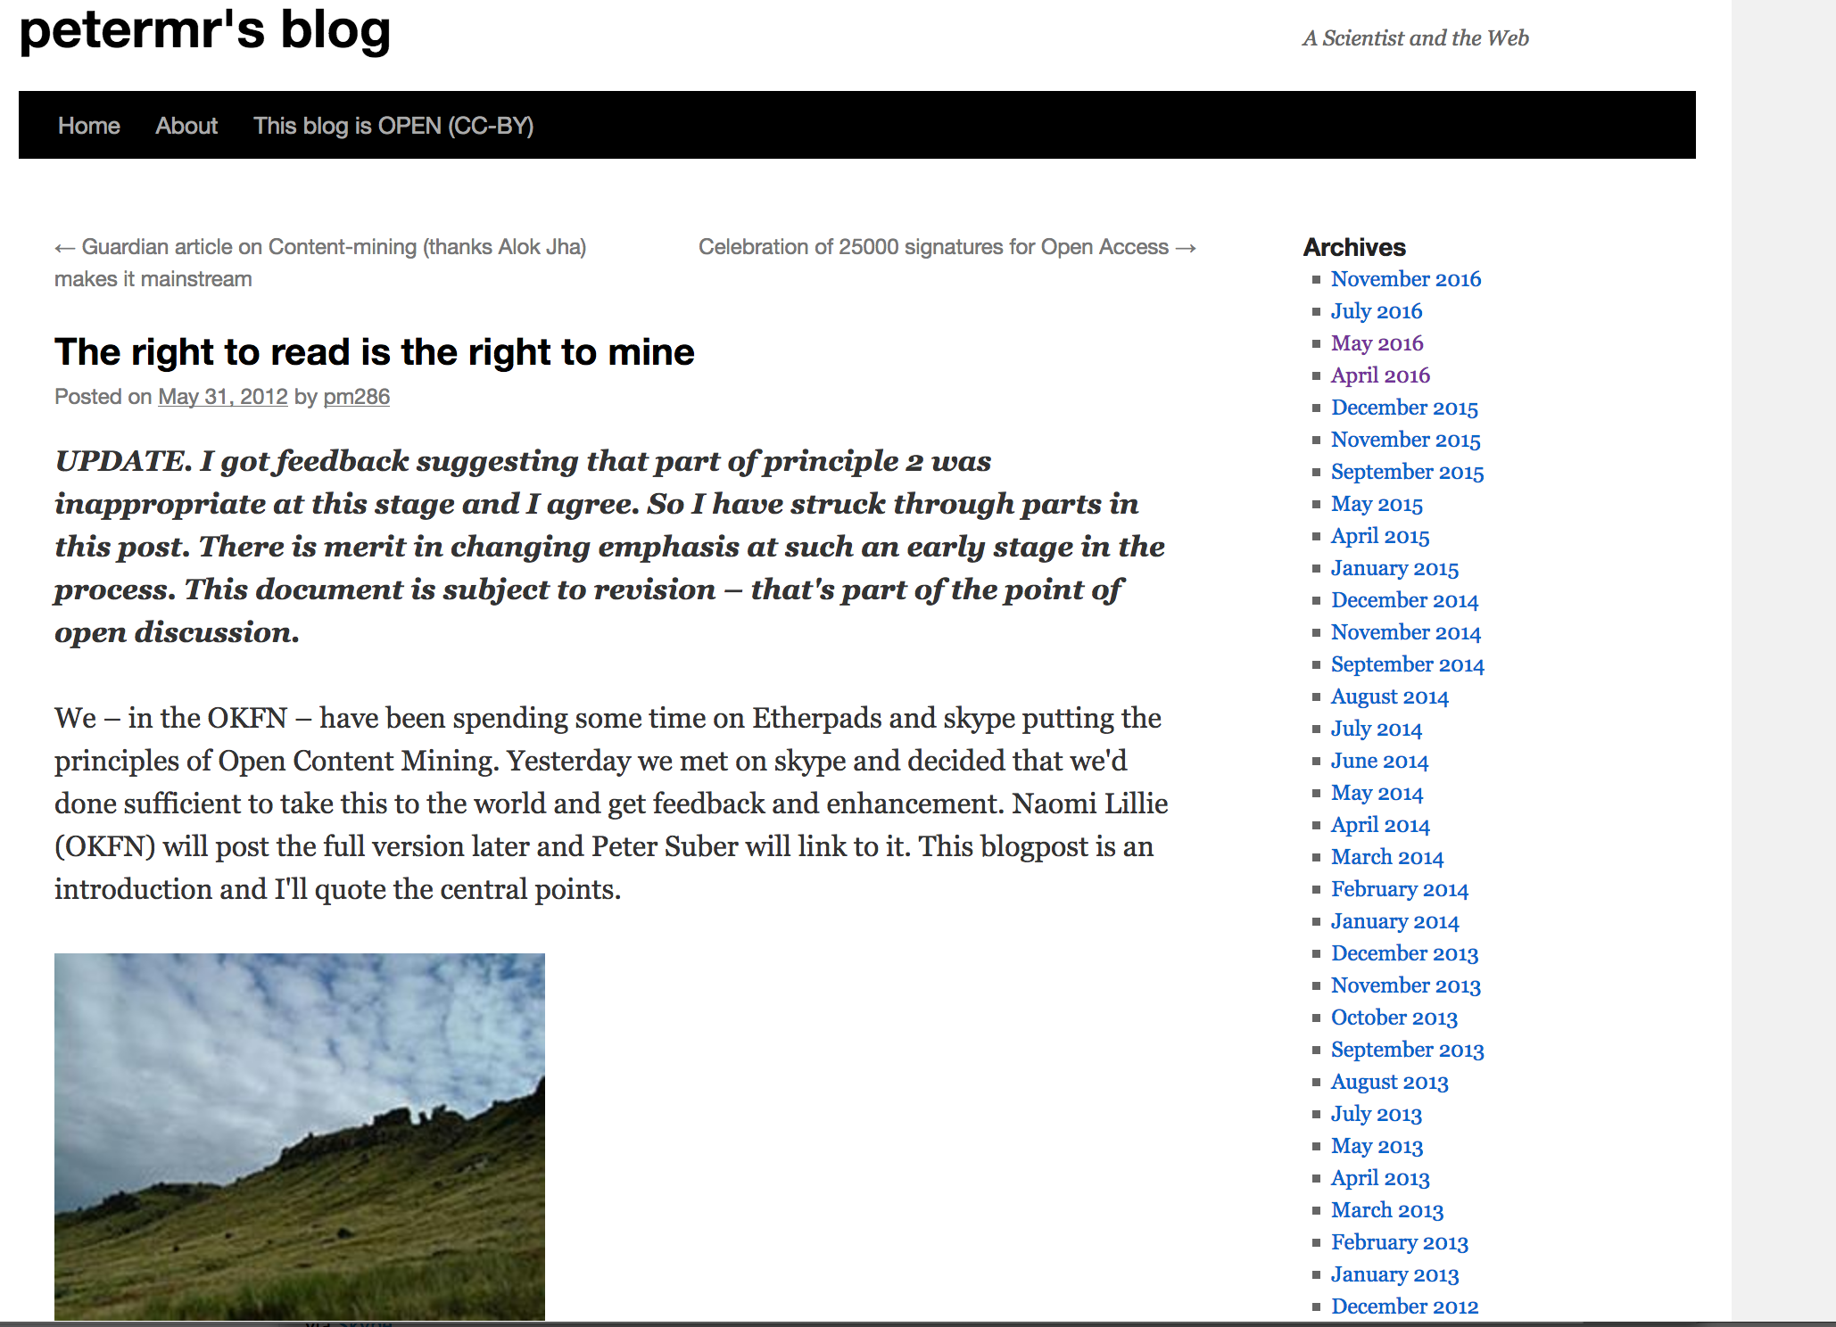
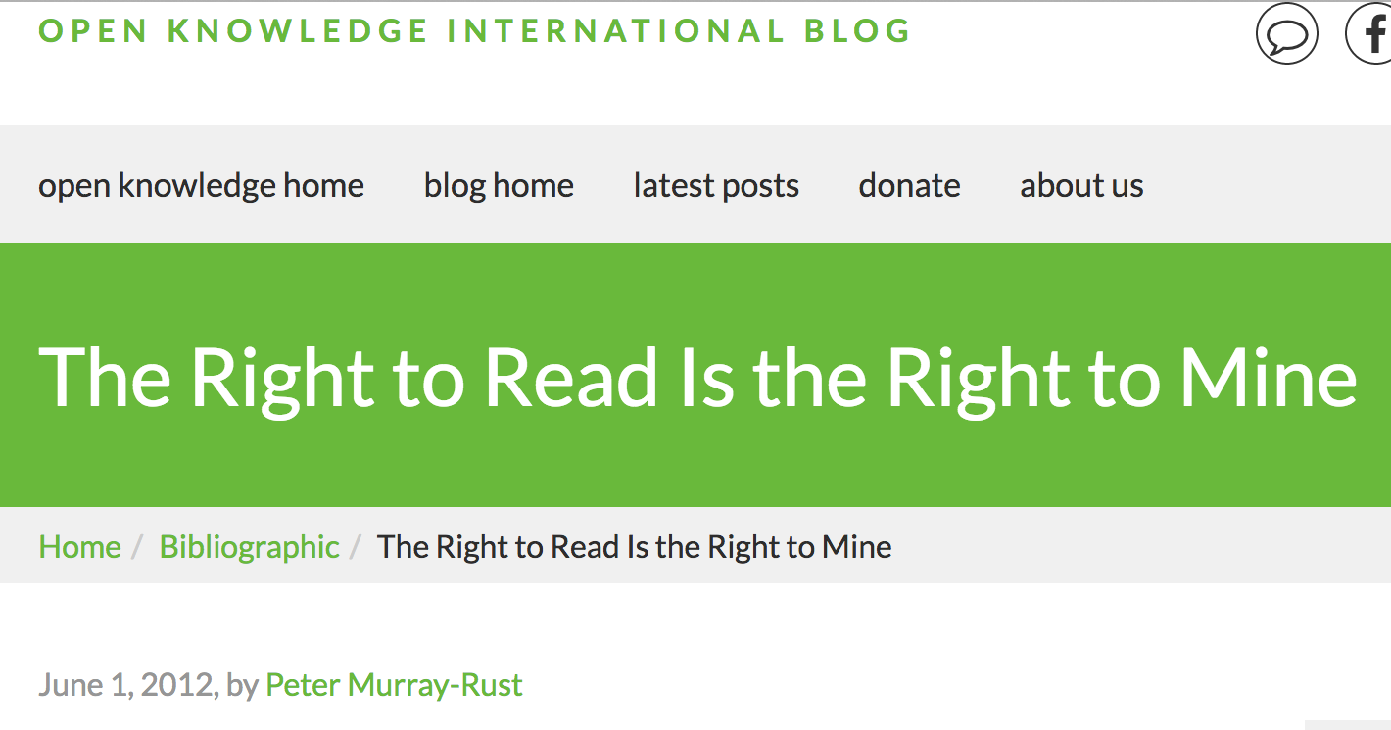

Slide 53
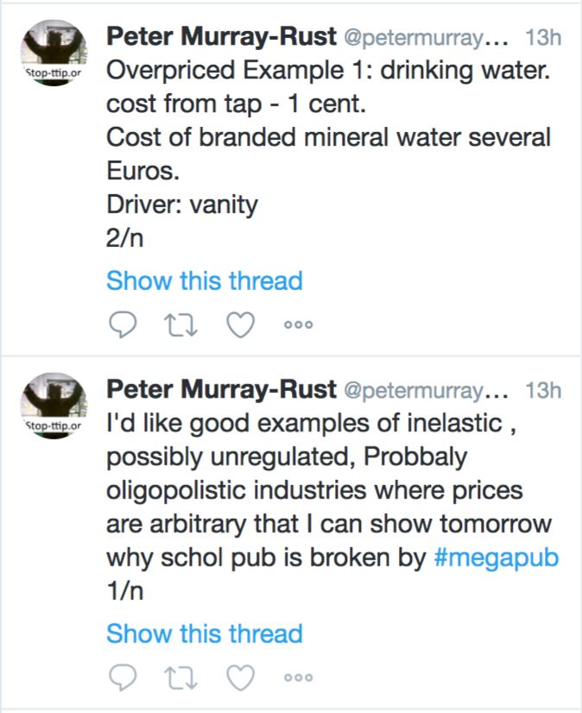
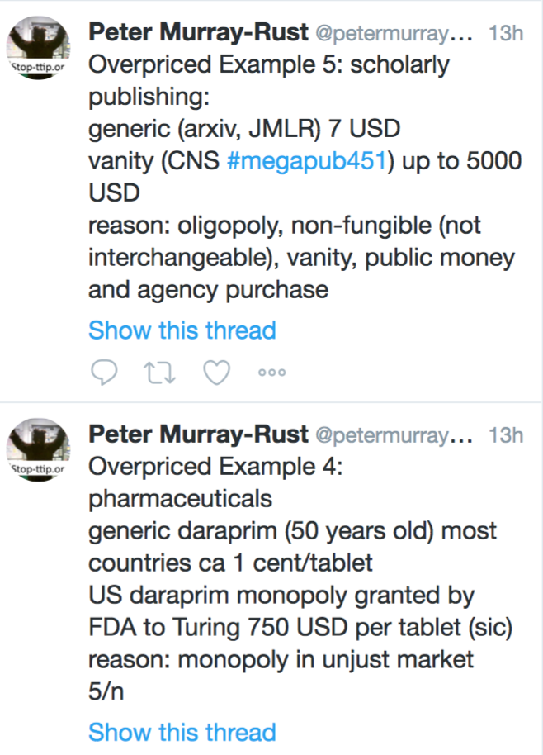
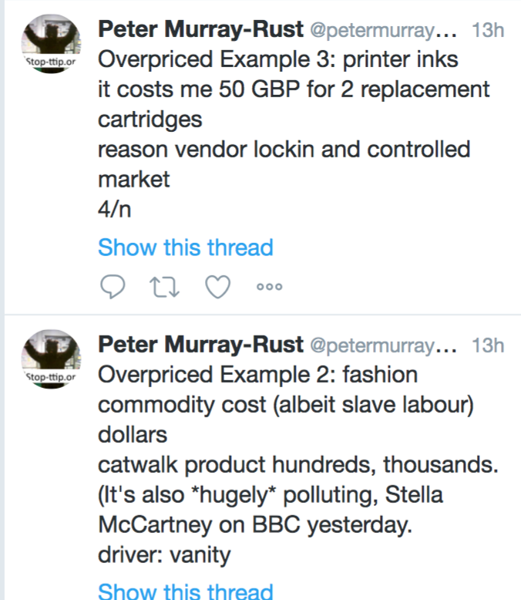

Slide 54
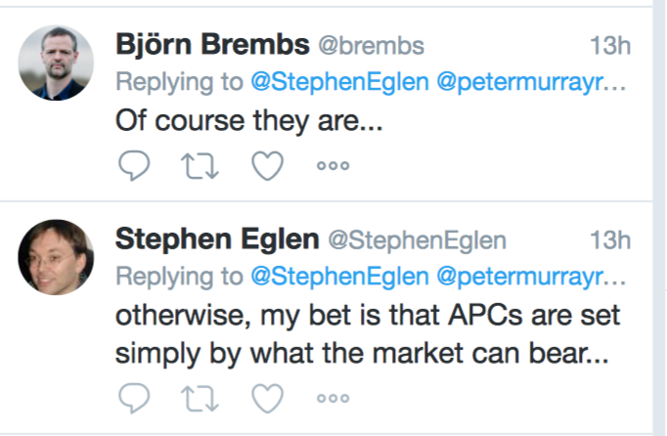

Slide 55
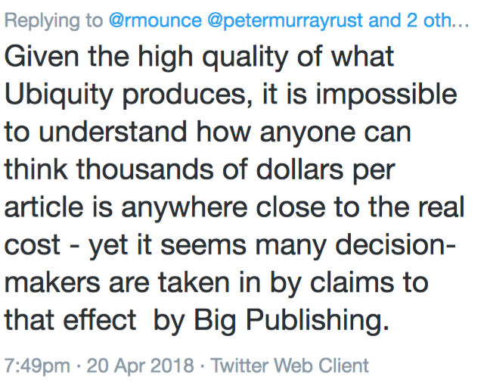
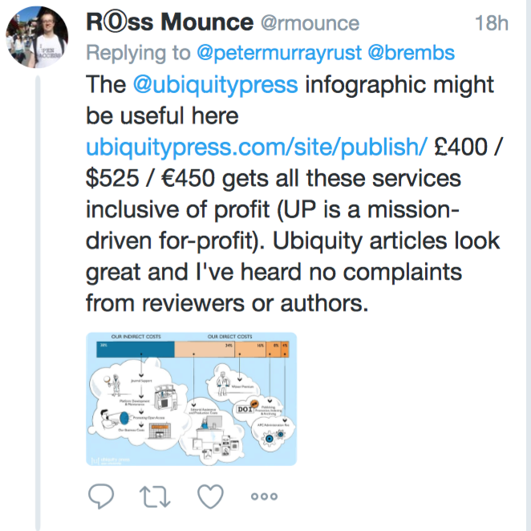

Slide 56
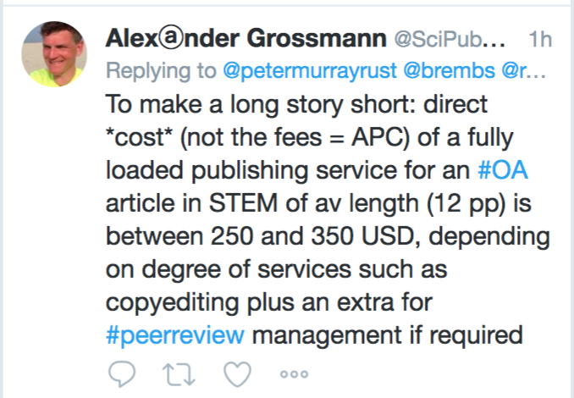
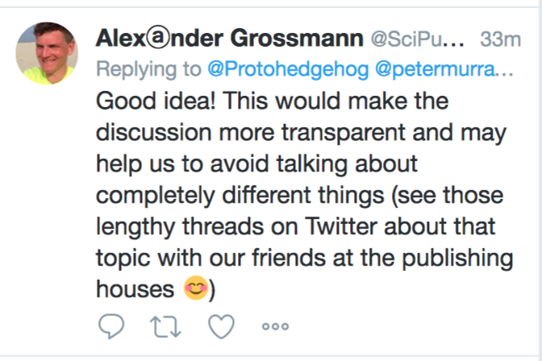

Slide 57
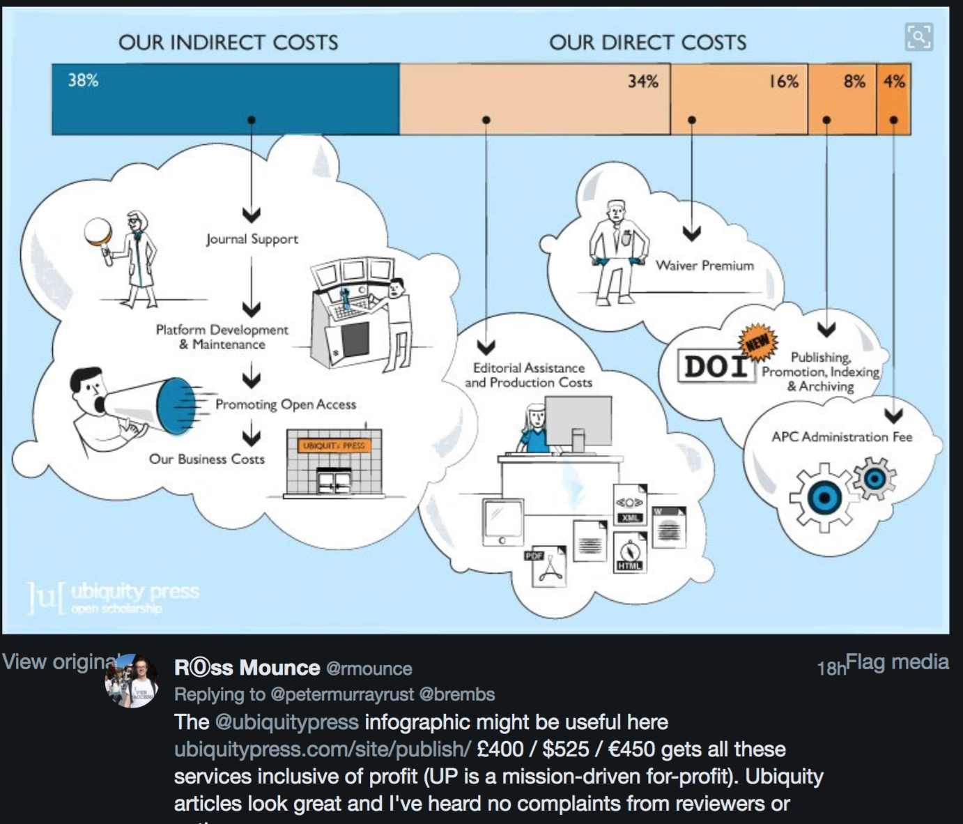

Slide 58
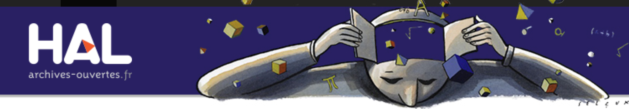
Open Scholarship must build its own discovery system before it is too late
Communities of Practice + software:
Wikip(m)edia
Open Street Map
Open Corporates
Theses are under OUR control and hugely valuable.

Slide 59
Problem
Advocacy/Activism
Community
Tools

Slide 60
6 ContentMine Fellows for 6 months

Slide 61

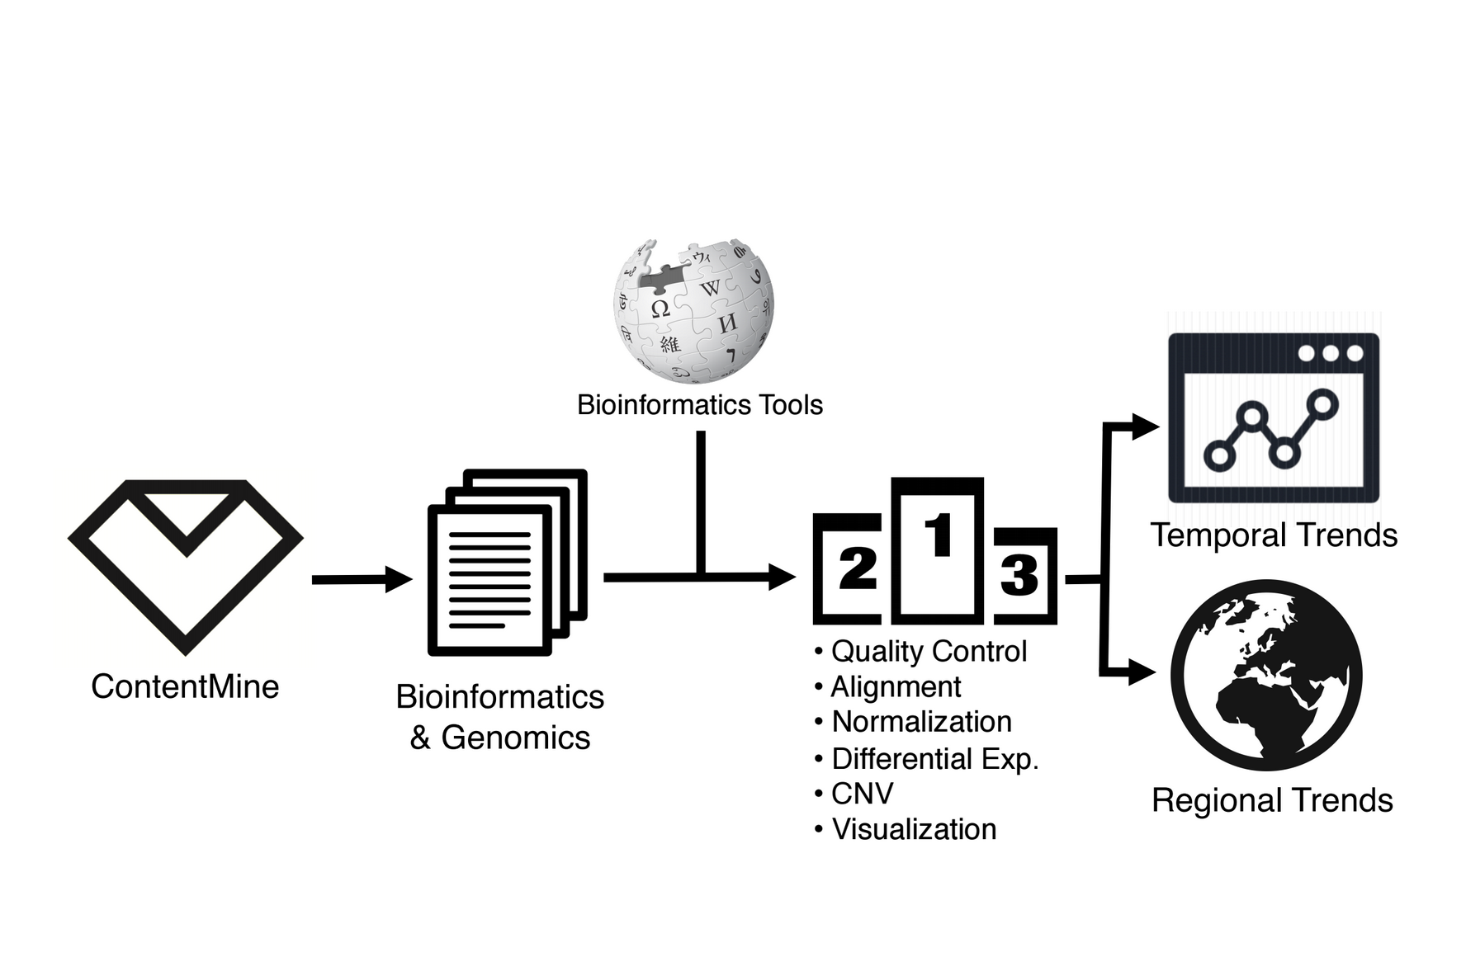
Neo Christopher Chung
Warsaw, Computational Biology
Wants to find out geographic and temporal differences in the use of genomic software tools

Slide 62
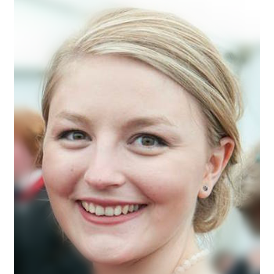
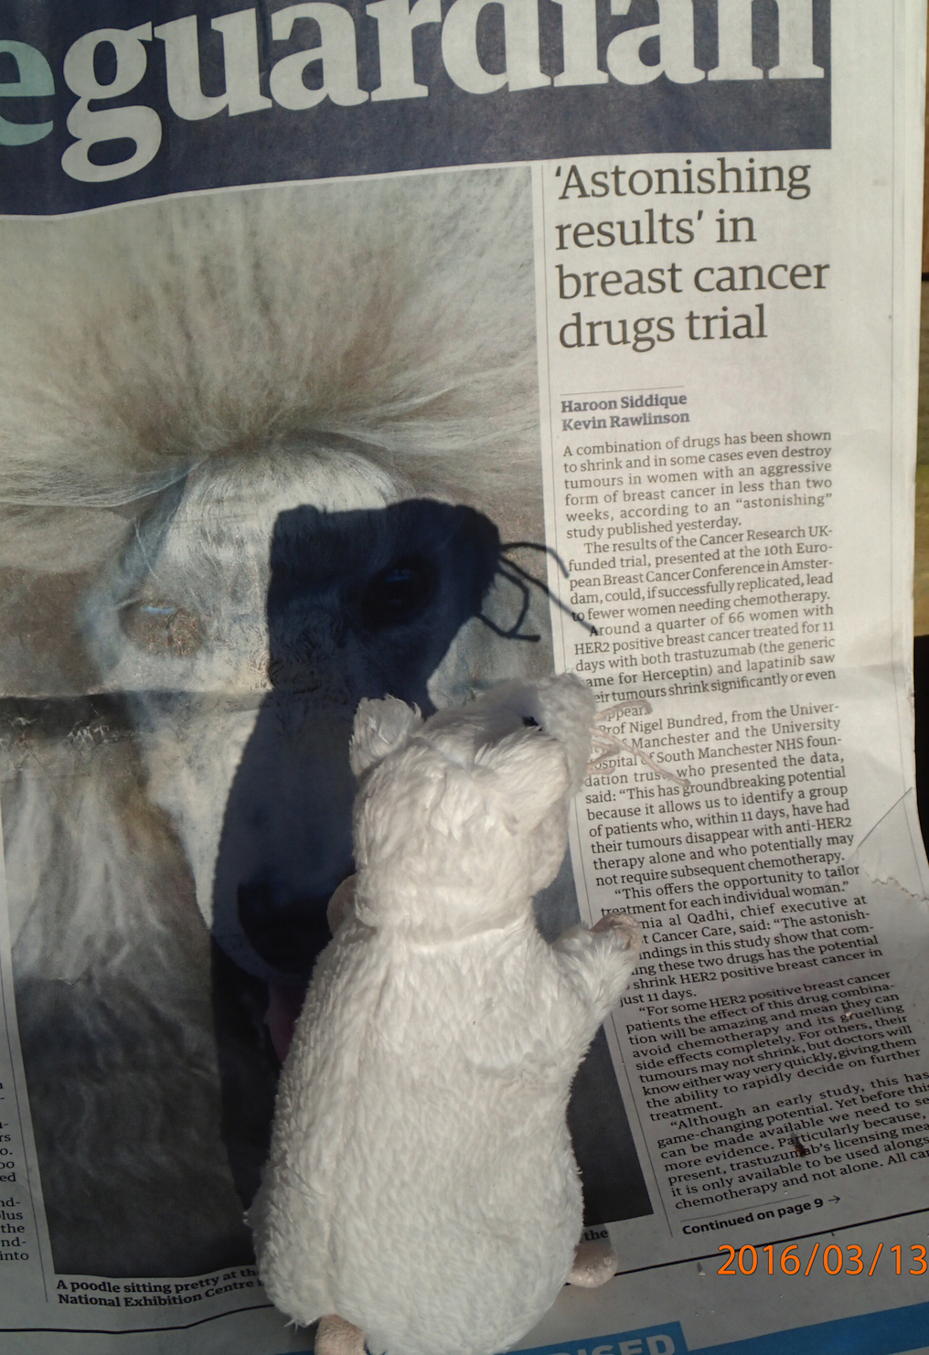
Alexandra Bannach-Brown
Edinburgh, Neuroscience
Problem: huge body of works in animal studies about depressions. systematic review is the main approach for getting insight.
Wants: identify papers in systematic review of depressive behaviour in animals. What drugs, what methods, what outcomes and signs/phenotypes. Use outcomes for document clustering.
and expedite scientific advances."
Corpus: 70.000 Papers

Slide 63

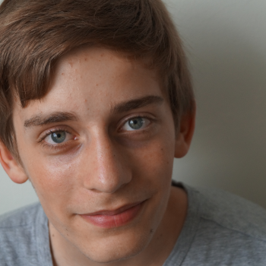
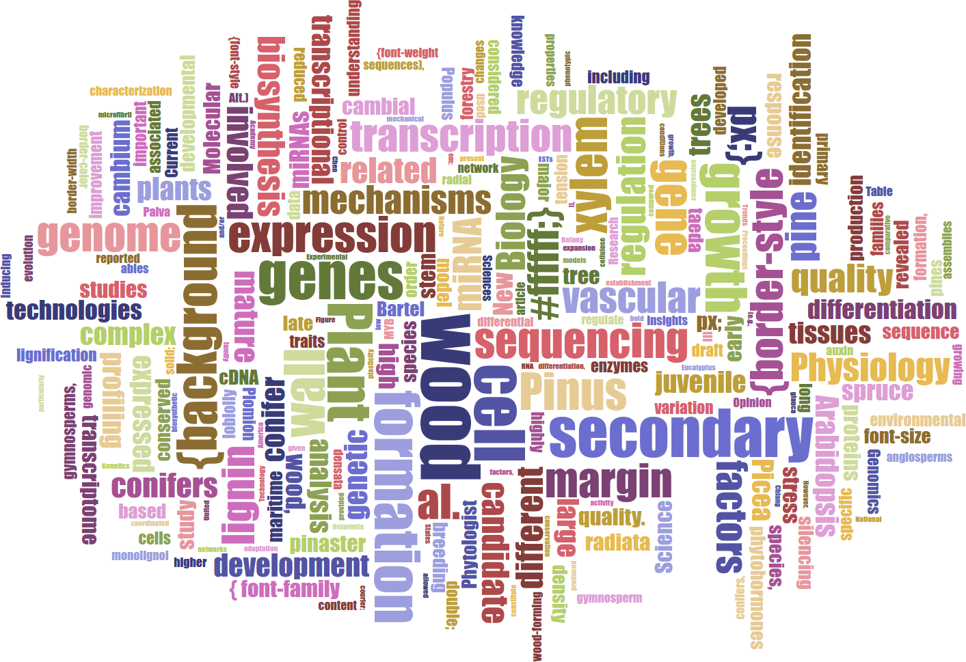
Lars Willighagen
15 years old NL
Wants: extract data about conifers (relations to chemicals, height etc.)
Outcome: database with webpage containing conifer properties
Table Facts Visualiser DEMO
Card DEMO
Word Cloud
„ I applied to this fellowship to learn new things and combine the ContentMine with two previous projects I never got to finish, and I got really excited by the idea and the ContentMine at large.“

Slide 64
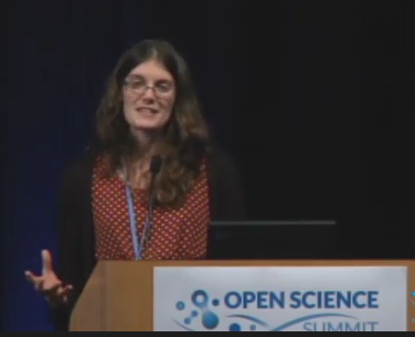
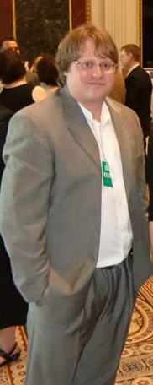
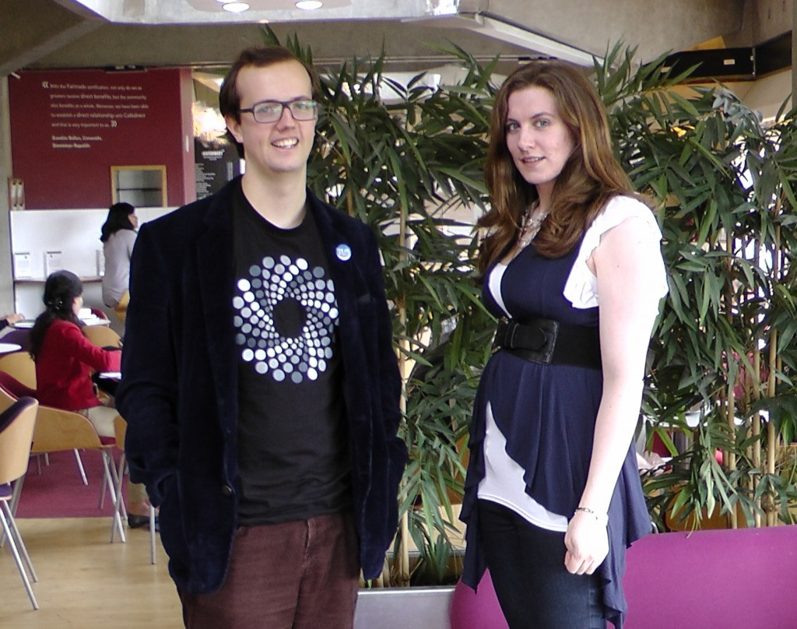
Some Children of the Digital Enlightenment
David Carroll & Joe McArthur: OAButton
Rayna Stamboliyska & Pierre-Carl Langlais
Jon Tennant
Ross Mounce
Jenny Molloy
Erin McKiernan
Jack Andraka
Michelle Brook
Heather Piwowar
TheContentMine Team
Rufus Pollock
Jonathan Gray
Sophie Kay
Jean-Claude Bradley [1] a chemist developed Open notebook science;
making the entire primary record of a research project publicly available online as it is recorded. (WP)
J-C promoted these ideas with UNDERGRADUATE scientists.
[1] Unfortunately J-C died in 2014; we held a memorial meeting in Cambridge
Sophie Kay

Slide 65
Problem
Advocacy/Activism
Community
Tools

Slide 66
The Digital Enlightenment: some of my icons
Berkeley, US, 1966
Paris, 1968
UK, 1969-73
Diderot, Paris, 1751

Slide 67
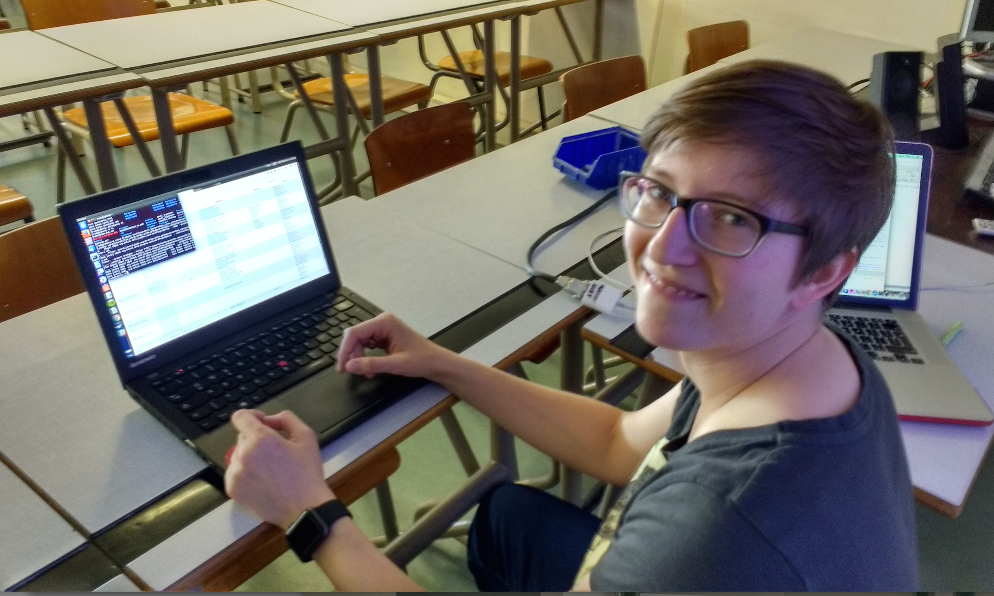
Julia Reda, Pirate MEP, running ContentMine software to liberate science 2016-04-16

Slide 68
ContentMine Scientist’s workbench
A platform independent, easily installed, toolkit based on the RESEARCHER’s filesystem (500-5000 articles)
Automatic downloading
Searching and filtering
Tagging and annotation
Repurposing

Slide 69


7 million articles, over 200 dictionaries
https://www.wikidata.org/wiki/Wikidata:WikiFactMine
ContentMine thanks the WikimediaFoundation for support

Slide 70

Search on publicly accessible papers on “Zika”
https://rawgit.com/ContentMine/amidemos/master/zika/full.dataTables.html

Slide 71


Slide 72
Where to reposit published crystallography?
Proteins -> PDB, Open
BUT
Inorganics -> ICSD Closed
Organics -> Cambridge (CCDC) Closed
SO
The community has built a Crystallography Open Database

Slide 73

Restrictions on Re-use of Crystallographic data
Crystallographic data from publications now belongs to CCDC
NOTE: The CCDC is based on data contributed by
scientists as part of publication and validation

Slide 74

www.crystallography.net
Open Source and Open Data

Slide 75

Interactive OPEN crystal search tool

Slide 76


Slide 77
Disruption
Must be BETTER
Must be COMMUNALLY OWNED
By citizens
Must be protected against pwning
Social principles, not technology

Slide 78
Our Future?
But it was all right, everything was all right, the struggle was finished. He had won the victory over himself. He loved Big Brother”
― George Orwell, 1984

Slide 79
Some WikiFactMine dictionaries*
402 Galaxies
501 Aviation accidents and incidents
701 Sovereign states
703 soil types
* Compiled by Charles Matthews

Slide 80




WikiFactMine has >500 expanded entries for “terpenes”

Slide 81

Prof. Ian Hargreaves (2011): "David Cameron's exam question”: "Could it be true that laws designed more than three centuries ago with the express purpose of creating economic incentives for innovation by protecting creators' rights are today obstructing innovation and economic growth?”
“yes. We have found that the UK's intellectual property framework, especially with regard to copyright, is falling behind what is needed.” "Digital Opportunity" by Prof Ian Hargreaves - http://www.ipo.gov.uk/ipreview.htm. Licensed under CC BY 3.0 via Wikipedia - https://en.wikipedia.org/wiki/File:Digital_Opportunity.jpg#/media/File:Digital_Opportunity.jpg

Slide 82

Asian and U.S. scholars continue to show a huge interest in text and data mining as measured by academic research on the topic. And Europe’s position is falling relative to the rest of the world.
Legal clarity also matters. Some countries apply the “fair-use” doctrine, which
allows “exceptions” to existing copyright law, including for text and data mining.
Israel, the Republic of Korea, Singapore, Taiwan and the U.S. are in this group.
Others have created a new copyright “exception” for text and data mining – Japan,
for instance, which adopted a blanket text-and-data-mining exception in 2009, and
more recently the United Kingdom, where text and data mining was declared fully
legal for non-commercial research purposes in 2014. Some researchers worry that
the UK exception does not go far enough; others report that British researchers are
now at an advantage over their continental counterparts.
the Middle East is now the world’s fourth largest region for research on text and data mining, led by Iran and Turkey.
http://www.lisboncouncil.net/publication/publication/134-text-and-data-mining-for-research-and-innovation-.html

